Slide 1
Coronavirus
Which region/country has the worst Coronavirus situation?
Leonard Choo

Slide 2
Agenda
01
Data Background
03
Underlying Factors
Recommendation
02
Metric
04

Slide 3
1. Data Background

Slide 4
7.9 B
Global Population
2020-2024
Data Collected
237
Countries Participated

Slide 5
Cases and Deaths Per Year
Cases Deaths
7.1M
Total Deaths
424M
4M
400M
3.5M
776 M
Total Cases
3M
300M
Cases
2M
Deaths
200M
200M
100M
1M
80M
69M
2M
0M
2020
2021
2022
Year
2023
2024
0M

Slide 6
Average Death/Case Rate

Slide 7
Pro: Includes only people who have covid
Con:
Includes only people who reported or tested positive

Slide 8
550,000
Average Cases Per Day
10,000
Average Death Per Day
1.8%
Average Death/Case Rate
=

Slide 9
Average Death/Case Rate
Year 2021
At least 5M population at country level

Slide 10
Death/Case Rate by Continent
1.8% Average Death / Case Rate
South America
2.9%
Africa
2.4%
North America
1.7%
Continent
South America & Africa has a higher than average Death/Case rate
Europe
1.6%
Asia
1.4%
Oceania
0.8%
0.0%
0.5%
1.0%
1.5%
Death/Case Rate
2.0%
2.5%
3.0%

Slide 11
Top 5 Countries with Highest Death/Case Rate
17.2%
15%
Yemen has the highest Death/Case rate
Death/Case Rate
10%
8.7%
8.2%
6.4%
6.3%
5%
1.8%
Average
Death/Case Rate
0%
Yemen
Peru
Sudan
Location
Somalia
Mexico

Slide 12
Top 5 Countries with Lowest Death/Case Rate
1.8% Average Death/Case Rate
1.5%
Death/Case Rate
Burundi has the lowest Death/Case Rate
1.0%
0.5%
0.3%
0.3%
0.3%
0.2%
0.0%
0.0%
Laos
Norway
United Arab Emirates
Location
New Zealand
Burundi

Slide 13
3. Underlying Factors

Slide 14
Deaths and Death/Case Rate by GDP Per Capita Group
Deaths Death/Case Rate
2.03M
2.0M
2.2%
Higher GDP Per Capita = Lower Death/Case Rate
2%
1.5M
Death/Case Rate
Deaths
1.0M
0.90M
1%
0.60M
0.5M
0.4%
0.01M
40k-60k 60k-80k
GDP Per Capita Group
0.00M
0.00M
0.0M
0K-20K
20k-40k
80k-100K
>100K
0%
* GDP per capita is the total value of a country's finished goods and services divided by its total population.
Notes:
GDP per capita is the total value of a country's finished goods and services (gross domestic product) divided by its total population (per capita).

Slide 15
Death/Case Rate by GDP Per Capita Group
60k-80k
GDP Per Capita Group
Countries with 0-20,000 GDP Per Capita has a higher tendency to have a high Death/Case rate
20k-40k
0K-20K
0%
5%
10%
Death/Case Rate
15%

Slide 16
Countries with low GDP per capita have a greater risk to have a high death/case rate

Slide 17
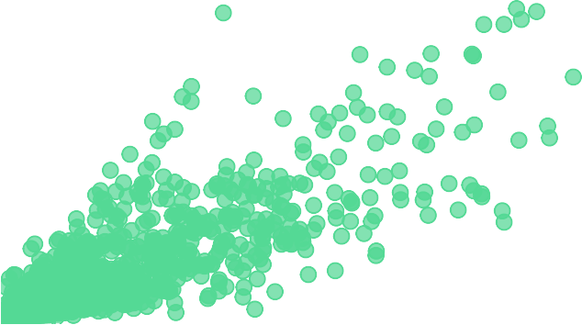
Patients/Bed by Deaths
1.34
Hospital Patient/Bed
20K
15K
Deaths
10K
There is a positive relationship
between Patients/Bed & Deaths
5K
0K
0
10
20
30
40
50
Patients/Bed

Slide 18
Average Patient/Bed by Continent
8.51
8
North America & Africa have a higher-than-average Patient/Bed Rate
6
Average Patient/Bed
4.08
4
2
1.34 Average Patient/Bed
0.71
0.56
0.45
0.34
0
North America
Africa
Asia
Europe
Oceania
South America
Continent

Slide 19
North American and African countries exhibit a higher patient-to-bed ratio compared to the average

Slide 20
4. Recommendation
Notes:
How can we prevent if another pandemic were to occur?

Slide 21
Recommendations
Gear Up
Mobilization
Data Collection
To increase GDP per capita to reduce deaths/cases
Examples: Investments, Education, Better Policies and Trade
To increase the number of hospital beds overall so that patients have adequate care
To include vaccinations and booster data separately

Slide 22
Thank You

Slide 23
Coronavirus
Appendix
Leonard Choo

Slide 24
Deaths and Death/Case Rate by Population Density Category
Deaths Death/Case Rate
2.77M
2.2%
2.5M
2.0%
2.0%
2.0M
1.8%
Death/Case Rate
Deaths
1.5M
1.6%
1.0M
0.5M
1.4%
0.39M
0.36M
0.03M
0.0M
Low
Medium
Population Density Category
High
Huge
1.2%
Notes:
Population density is the concentration of individuals within a species in a specific geographic locale. 200 400

Slide 25
Deaths and Death/Case Rate by HDI Scale
Deaths Death/Case Rate
2.67M
2.0%
1.9%
2.5M
1.8%
1.8%
2.0M
Death/Case Rate
Deaths
1.5M
1.6%
1.0M
0.85M
1.4%
0.5M
0.01M
0.01M
0.0M
Poor
Ok
Good
Very Good
1.2%
HDI Scale
Notes:
A long and healthy life, access to knowledge, and a decent standard of living. The HDI is a score between 0 and 1, with higher values indicating a higher level of human development.

Slide 26
Deaths and Vaccinations by Year
Deaths Vaccinations
4M
135.1%
Vaccination Rate
8bn
3M
6bn
Vaccinations
Deaths
2M
4bn
1M
2bn
0M
2020
2021
2022
Year
2023
2024
0bn

Slide 27
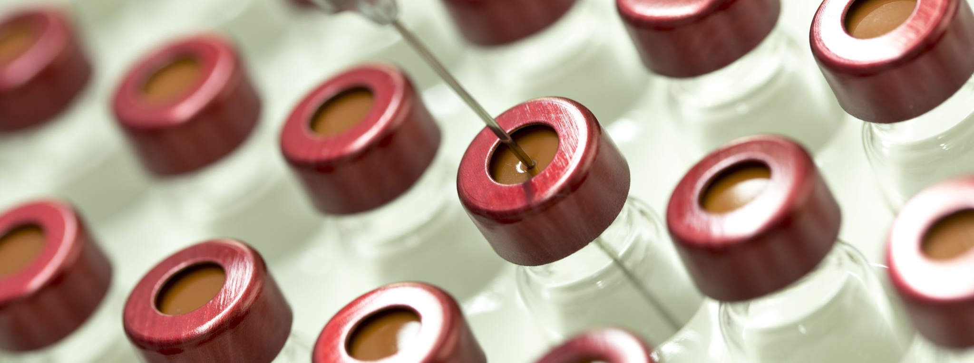
Number of vaccinations includes booster jabs

